Slide 1
Smart Health Report
In an era marked by dynamic lifestyles, rapid technological advancements, and evolving environmental challenges that encompass us, the significance of health awareness initiatives in our society cannot be overstated.
The following presentation aims to shed the spotlight on the intricate insights drawn from reliable data.
The main goal is to foster a deeper understanding of the diverse health trends and issues facing the young, mature and elderly in the community.
Below are some key questions that and key findings generated in attempt to answer them.

Slide 2
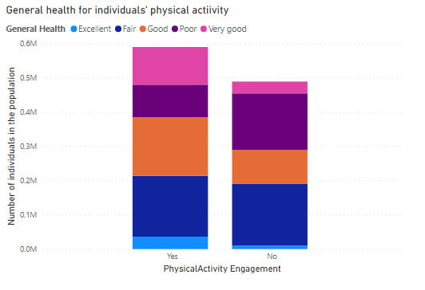
How does physical activity impacts one’s general health?
-Based on the line stacked column bar chart visual, we can see that those members of the population who engaged in physical activity; recorded positive general health remarks(Excellent, Very good, Good, Fair) in comparison to those who did not engage in physical activity.
- Furthermore, those who did not partake in physical activity had more negative general health remarks(Poor)in comparison to the individuals who engaged in physical activity
- This insight leads to the reinforces the realization that physical activity is crucial for one to be able to maintain a good healthy lifestyle.
- Thus, the elderly and mature in the society who are more prone to ailments in comparison to other age groups; should be encouraged to engage in physical activities such as walking, jogging etcetera.

Slide 3
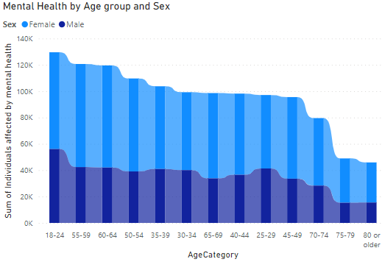
Are the youth the most affected when it comes to mental health issues?
- Over the years, there has been a sharp increase of deaths by suicide thus making mental health a major issue; amongst the members of the societ; ranging from issues such as depression, anxiety ,and behavioral disorders.
- I seek to establish which age group is most affected by mental health based on the reliable data at hand.
- The ribbon chart visual relays a key insight, that is; the youth are the most affected age group when it comes to issues pertaining mental health.
-This means that more initiatives need to be developed and awareness raised amongst the youth regarding mental health and how to manage their mental health at this stage of their lives.

Slide 4
Which gender is mostly affected by mental health issues?
- Still on the subject of mental health, I would like to establish which gender is most affected by matters mental health
- Based on the ribbon chart, we can decipher that the female gender is the most affected when it comes on the topic of mental health in comparison to the male gender
-This is because based on the masses affected across the age groups, we can see that the female gender occupies larger portions of the columns
-This can be attributed to the various factors that render women vulnerable to the mental health disorders such as gender discrimination, societal pressures and expectations etcetera

Slide 5
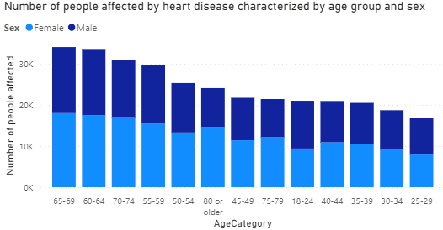
Which gender and age group is more vulnerable to heart diseases and complications?
-Based on the line and stacked column visual, we can unravel that individuals aged between the ages of 65-69 are more vulnerable to heart diseases and complications in comparison to other age groups
- Moreover, the visual demonstrates that individuals in their sixties are in great danger of getting heart diseases and complications
- Furthermore, according to the visual, health disease is of more significant threat to the female gender than their male counterparts.

Slide 6
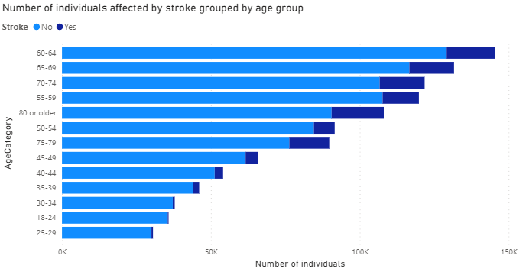
Which age group is the most vulnerable to get stroke?
- In recent years, occurrence of strokes amongst individuals has been on the rise thus using the data, I seek to establish which age group in the society is most vulnerable
-As seen in the stacked bar chart, we can note that the most affected age group is the sixties, eighties and closely followed by the seventies age bracket.
-Thus, individuals in this age brackets should be given more care and attention health wise in order to prevent them from suffering stroke, which in severe cases leads to paralysis.

Slide 7
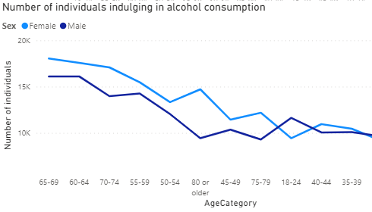
Discerning alcohol intake in terms of age group and gender
- The line chart depicts the trends in alcohol consumption amongst different age groups and by gender.
- Upon some analysis, we can decipher that alcohol consumption is significantly higher amongst the older age groups in comparison to the youth.
- Another observation is that females tend to drink more in older age groups, that is; above 35 years
- As for the youth( 18 – 24 years), we can see that the male gender is more involved in alcohol consumption than their female counterparts

Slide 8
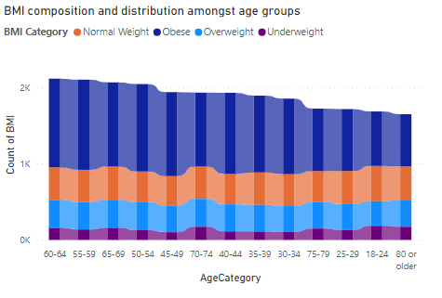
Investigating obesity amongst the age group using their BMI
- According to WHO(World Health Organization), Obesity has recently become an issue has grown to epidemic proportions, with over 4 million people dying each year as a result of being overweight or obese in 2017 according to the global burden of disease.
- Thus, I sought to establish whether the same applies to the age groups found in the dataset.
-As per the stacked area chart visual, we can see that obesity truly is a menace as majority of the populace across the various age groups are obese.
-Furthermore, it seems that individuals in the sixties and fifties categories contain many obese individuals which is a cause for concern

Slide 9
CONCLUSION
- The visuals have pointed out a number of health concerns that are affecting the population especially the female gender
- The health issues include mental health, alcoholism, and heart complications.
- As such, more health initiatives and awareness campaigns should be prioritized not only to the female gender but also to all age groups in order to make the population cognizant of these posing health threats.
- We have also established that obesity is a serious issue as majority of people across the various age groups are obese and thus more measures need to be put in place to curb this growing epidemic.
-In conclusion, it is my hope that the insights a raised from this report will be taken into consideration by the various concerned stakeholders upon future decisions and policies made.

